Slide 1

Javascript Functions
M3-02
Participate! The more engagement the better! You are NEVER interrupting me!

Slide 2
Session Objectives
Review of Javascript Scope
Named Functions
Function Parameters
Optional Parameters
Parameter Default Values
Anonymous Functions
Array Functions (Filter, Map, Reduce, ForEach)
Function Documentation

Slide 3
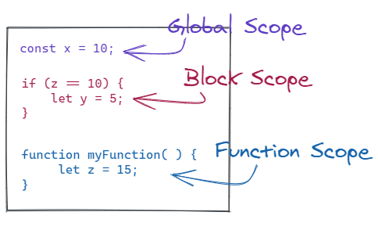
Scope
JavaScript has 3 Scopes
Global Scope
declared outside of a block or function
available everywhere
Block Scope
variables are available in the block in which they are created
like Java
if, for, etc.
let and const obey block scope
var ignores block scope
Function Scope
Variables created in a functions block are only available in that function
var, let, and const all obey function scope

Slide 4
Named Functions
Named functions have ‘names’ and use the function keyword. They are called simply by using the name of the function and passing in any parameters
function addTogether(firstParameter, secondParameter) {
return firstParameter + secondParameter;
}

Slide 5
Function Parameters
Function parameters are optional, but may give unintended results
const result = addTogether(firstParameter, secondParameter);
const result = addTogether(firstParameter);
const result = addTogether();
function addTogether(firstParameter, secondParameter) {
return firstParameter + secondParameter;
}

Slide 6
Parameters Default Values
We can set the default value if a parameter is not passed in.
let result = addTogether(firstParameter, secondParameter);
result = addTogether(firstParameter);
result = addTogether();
function addTogether(firstParameter = 0, secondParameter = 0) {
return firstParameter + secondParameter;
}

Slide 7
Anonymous Functions
Anonymous functions are functions without a name. We can assign a function to a variable. This assignment is called a function expression, and since it is ‘assigned’ to a variable, we don’t need to name the function. We can simply refer to it by it’s variable name when we want to invoke it.
(See lecture code demo)

Slide 8
Anonymous Functions
Anonymous functions have parameters and a code block, but do not have a name.
Can be assigned to variables
Can use the function keyword:
const doubleSum = function (x, y) {
let val = (x + y) * 2;
return val;
}
doubleSum(2, 4);
Or the the arrow operator ( => )
const tripleSum = (x, y) => {
let val = (x + y) * 3;
return val;
}

Slide 9
Dealing with an unknown number of Parameters
A default value can be set in the function parameters:
function addNumberAndString( x = 0, str = ‘’) { }
The arguments object is automatically passed to all JavaScript functions and can be used to determine the number and value of the arguments.
function unknownParams() { const numberOfArguments = arguments.length; }
The arguments object may look like an array, but it is not. It can be converted to an array using Array.from()
const argumentsAsArray = Array.from(arguments);

Slide 10
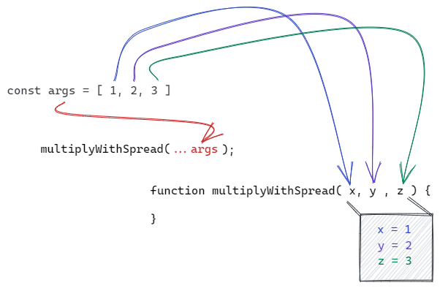
Spread Operator
Spread syntax allows iterables such as an array or string to be expanded in place to fill arguments.
function multipleWithSpread(x, y, z) { return x * y * z; }
const args = [1, 2, 3]; multipleWithSpread(...args);

Slide 11
Array forEach() function
Loops through the values in the array 1 at a time, similar to a Java for each
https://developer.mozilla.org/en-US/docs/Web/JavaScript/Reference/Global_Objects/Array/forEach
Array.forEach()
Takes an anonymous function as an argument, that function will be passed the following arguments:
Current value
index
array
Does not return a value

Slide 12
Array filter()
filter()
Creates a new array of values from the original array that match a condition
https://developer.mozilla.org/en-US/docs/Web/JavaScript/Reference/Global_Objects/Array/filter#Description
That condition is created by an anonymous function that is passed 3 values
Current value from the array (item)
Current index
Array
Anonymous function should return true if the value should be included in the new array, and false if it should not be included

Slide 13
Array map()
map()
Creates a new array of all the values from the original array changed in a way defined by an anonymous function
https://developer.mozilla.org/en-US/docs/Web/JavaScript/Reference/Global_Objects/Array/map
That condition is created by an anonymous function that is passed 3 values
Current value from the array (the item)
Current index
Array
Anonymous function should the new value for the same index in the new array

Slide 14
Array reduce() function
Aggregate the values in an array to a single value
https://developer.mozilla.org/en-US/docs/Web/JavaScript/Reference/Global_Objects/Array/reduce#Description
Array.reduce()
Takes an anonymous function as an argument, that function will be passed 4 arguments:
Aggregated value
Current value
index
array
returns the aggregated value

Slide 15
Other useful functions of an array
indexOf()
lastIndexOf()
find()
findIndex()
findLast()
findLastIndex()

Slide 16
JSDoc (Function Documentation)
/**
Should document what a function does, but not how it works
Each parameter should document
@param
data type
name
what it represents
@param {data type} name description
If there is a return, it should be document
@returns
data type
description
@returns {data type} description

